Slide 1



Blazor, a new .NET Single Page App Framework
Carl in ’t Veld
29 oktober 2019
Notes:
Prepare:
Warm-up: https://carlintveldblazor.azurewebsites.net
Preparation steps:
* Deinstall: PWA
* Chrome
- Blazor WebAssembly app: http://localhost:54385/ (experiments repo: https://github.com/cveld/blazor-experiments)
- Blazor Server app: https://localhost:44345/ (experiments repo)
- Blazor DualMode: http://localhost:60369/ (BlazorDualMode repo: https://github.com/Suchiman/BlazorDualMode)
- Blazor Experiments app: https://localhost:44316/
- PWA example: https://krdmllr.github.io/DotnetPwaSample/ Konrad Müller
- https://carlintveldblazor.azurewebsites.net
* Visual Studio Preview
- Blazor Experiments repo https://github.com/cveld/blazor-experiments
- Blazor Dual Mode https://github.com/Suchiman/BlazorDualMode
* Visual Studio
- Components Electron https://github.com/aspnet/AspLabs/tree/master/src/ComponentsElectron

Slide 2




About me
Carl in ’t Veld
Full stack software engineer
MCSD App Builder
@cveld
@CapgeminiNL

Slide 3
Agenda
What is Blazor
Hosting models: Blazor Server and Blazor WebAssembly
Blazor features:
Building a Blazor component
Applying Material Design
Form validation
Authentication
JavaScript interop
Experiment: Cross circuit communication
Future of Blazor
Next steps
Notes:
2 min

Slide 4







https://...
JS

Slide 5


Blazor
Build client-side web UI with .NET instead of JavaScript
Write reusable web UI components with C# and Razor
Share .NET code with both the client and the server
Call into JavaScript libraries & browser APIs as needed
C#

Slide 6
Blazor on client or server
Blazor WebAssembly
Blazor Server
https://...
https...
.NET Core
Razor Components
DOM
SignalR
DOM
.NET
WebAssembly
Razor Components
.NET
May 2020
.NET Core 3.0
Notes:
.NET Core 3.0 released 23 September 2019
November 2017 Mozilla declared support in all major browsers for WebAssembly (https://blog.mozilla.org/blog/2017/11/13/webassembly-in-browsers/)
Demos:
Blazor new project experience
Browser: WebAssembly

Slide 7
Demos
Visual Studio Project New experience
Blazor WebAssembly in the browser
Blazor Server in the browser
Notes:
Why Mono? See https://github.com/aspnet/Blazor/issues/286
Mono support for WebAssembly is committed (https://www.mono-project.com/news/2017/08/09/hello-webassembly/) and has been making steady progress. Mono is already the Microsoft support .NET runtime for a variety of client scenarios (Android, iOS, macOS, games) and is a natural fit for Blazor.
In the .NET 5 timeframe we will probably see some convergence between CoreRT and Mono.
WebAssembly behavior:
Static files
Mono runtime
.NET assemblies

Slide 8
Blazor on client or server
Blazor WebAssembly
Blazor Server
Pro:
True SPA, full interactivity
Utilize client resources
Supports offline, static sites, PWA scenarios
Con:
Larger download size
Requires WebAssembly
Still in preview
Pro:
Smaller download size, faster load time
Running on fully featured .NET runtime
Code never leaves the server
Simplified architecture
Con:
Latency
No offline support
Consumes more server resources
May 2020
.NET Core 3.0

Slide 9
Demo
Dual mode Notice the combination of server pre-rendering and WebAssembly
Credits for Robin Sue! https://github.com/Suchiman/BlazorDualMode
Notes:
Dual Mode:
https://github.com/Suchiman/BlazorDualMode
?mode=server

Slide 10
DEPENDENCY INJECTION
SERVER-SIDE RENDERING
COMPONENT MODEL
FORMS & VALIDATION
DEBUGGING
PUBLISHING
ROUTING
LAYOUTS
UNIT TESTING
AUTO REBUILD
ASSEMBLY TRIMMING
JAVASCRIPT INTEROP
INTELLISENSE & TOOLING
COMPONENT PACKAGES
Notes:
Demos:
Building a component
Component library
Forms validation
JavaScript interop
Authentication

Slide 11
Demos
Building a Blazor component
Integrating a Material Design components library
Building a modal dialog
Adding form validation
Adding authentication
Adding JavaScript interop
Adding Razor components to existing Razor pages
Notes:
Show WebSocket traffic

Slide 12
Personal take aways
Pros:
Great to have a single Visual Studio experience
Ready for enterprise employee facing apps or small to medium user bases
Cons:
Rough edges in Intellisense will certainly improve towards 3.1
Some limitations in JavaScript event processing
No hot reload will be addressed in .NET 5 timeline
No css and js bundling
No css component isolation community solution available *)
*) https://github.com/chanan/BlazorStyled/ Chanan Braunstein
Notes:
E.g. Quick Actions are not available
Broken library files are not discovered

Slide 13
Performance: using Blazor Server at scale
Test basis: default Blazor template and a Blazor Server port of the Blazing Pizza app used for the Blazor workshop (https://aka.ms/blazorworkshop).
Results:
Standard_D1_v2 instance on Azure (1 vCPU, 3.5 GB memory) could handle over 5,000 concurrent users without any degradation in latency.
Standard_D3_V2 instance (4 vCPU, 14GB memory) handled well over 20,000 concurrent clients.
The main bottleneck for handling further load was available memory.
Additional updates on improvements in Blazor Server planned
Source:
https://devblogs.microsoft.com/aspnet/blazor-server-in-net-core-3-0-scenarios-and-performance/
Danial Roth, Product Manager Blazor, 10 October 2019
Guidance ~250 kB per user as a bare minimum:
https://docs.microsoft.com/en-us/aspnet/core/host-and-deploy/blazor/server?view=aspnetcore-3.0

Slide 14
Blazor Server 3.1
Expected November 2019
Pass parameters to top-level components
Partial classes
https://devblogs.microsoft.com/aspnet/asp-net-core-updates-in-net-core-3-1-preview-1/

Slide 15
Real-time Webapps: Cross circuit commucation
https://carlintveldblazor.azurewebsites.net

Slide 16
Demos
Like
Book
https://carlintveldblazor.azurewebsites.net

Slide 17
Web
Blazor Server
Web app
Every interaction handled on server
Prerendered HTML (optional)
Blazor WebAssembly
Web app with client-side execution
Loaded from web server
Can work offline via Service Worker
Blazor PWA – OS installed
Appears as native app (own window)
Works offline or online
Blazor Hybrid
Native .NET renders to Electron / WebView
Appears as native app (own window)
Works offline or online
Desktop
+ Mobile
Blazor Native
Same programming model, but
rendering non-HTML UI
Notes:
PWA:
https://medium.com/@k.l.mueller/create-progressive-web-apps-with-net-using-blazor-6aa719e38000
https://krdmllr.github.io/DotnetPwaSample/ Konrad Müller
Electron:
https://github.com/aspnet/AspLabs/tree/master/src/ComponentsElectron -> TestApp

Slide 18
Blazor roadmap
Blazor Server – Shipped with .NET Core 3.0!
Blazor Server 3.1 – November 2019
Blazor WebAssembly – May 2020
Blazor PWA & Electron – Previews with .NET 5
Blazor Native – Under investigation

Slide 19
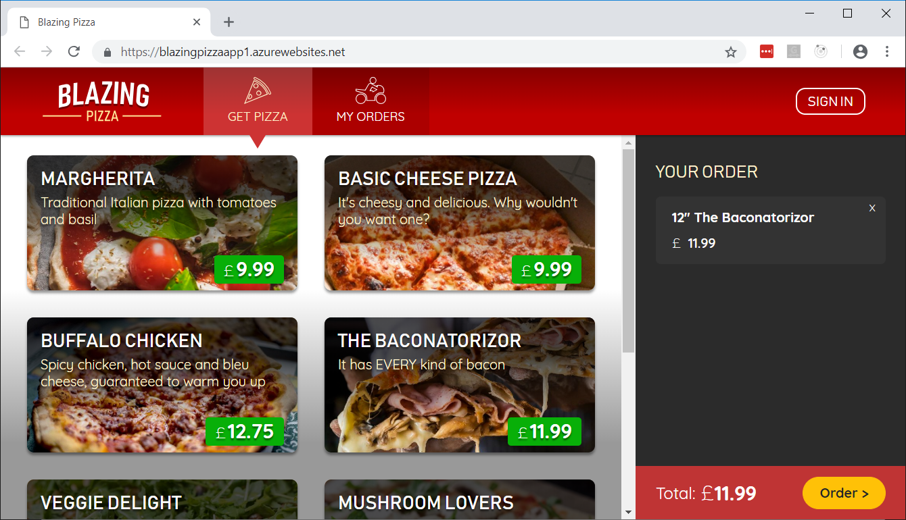
Next steps
Blazor: https://blazor.net
Docs: https://blazor.net/docs
.NET Core 3.0: https://dot.net/get-core3
Visual Studio: https://visualstudio.com/
Workshop: https://aka.ms/blazorworkshop
Community: https://aka.ms/awesomeblazor
Demo repository: https://github.com/cveld/blazor-experiments

Slide 20
Thanks for attending

